Slide 1

Java Full Stack Development
5. IntelliJ Setup and Navigation

Slide 2
Module Topics
Introduction to IntelliJ
Project setup and configuration
Navigation in a large codebase
Code Inspections and intentions
Refactoring

Slide 3

IntelliJ
IntelliJ IDEA is a polyglot IDE developed by JetBrains
  Java native support is built into the core engine
  Tools operate on a fully resolved semantic model of the code, not a best-effort parse
    For example: static analysis tools, refactoring engine, code generation, and debugger
    Every inspection, 'Extract Method', 'Find Usages' execution operates against the real type graph of a project
  VS Code uses language server extensions
    Provides language server protocol (LSP) support
    Architecturally more limited
    Especially for large-scale refactoring, Spring-specific inspection, and deep framework integration

Slide 4
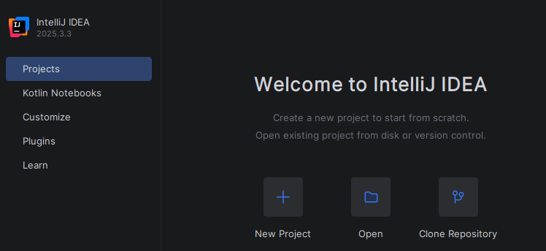
Project Setup
IntelliJ IDEA organizes work on a project basis
Setting are set up at the IDE level
  These are defaults for each project
  These can be overridden for project specific settings

Slide 5
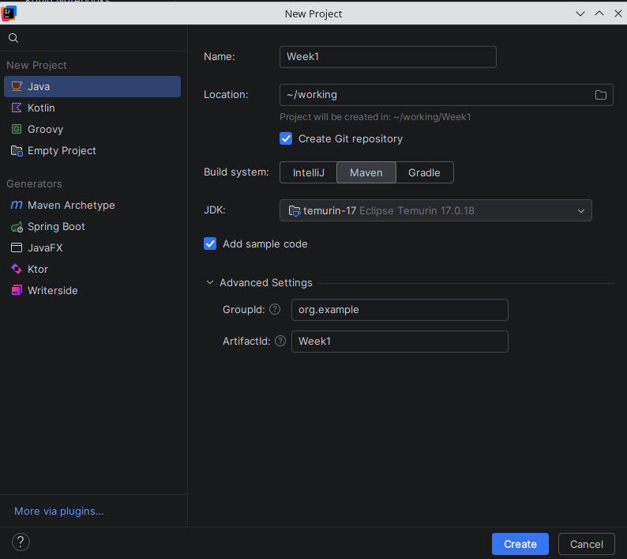
Project Setup
There are two JVMs used
  IntelliJ is a Java application so the system JVM is used, in this case Java 25 to run the IDE
  The project JVM is used to compile and run the code in the project which may be any other Java version
    In the screenshot, the project JVM is Java 17
The default build tool is selected
  We will be using Maven for this class

Slide 6
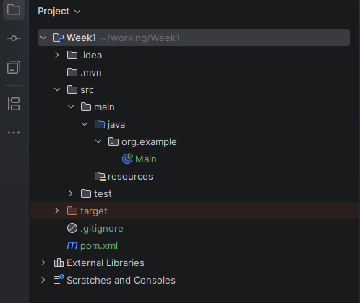
Project Setup
The project shown was generated by the sample code option
  The directory structure is a standard Maven project structure
  The src folder contains three subfolders
    The main folder that contains the code
    The test folder that contains the unit tests
    The resources folder that contains other project artifacts like config files, images, etc
  The compiled and packaged code is in the target directory
  The External Libraries are all of the class libraries used in the project

Slide 7
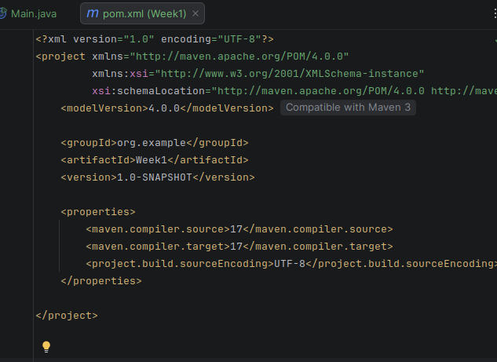
Pom.xml File
The pom.xml file is the single source of truth for the project
  Note that pins the Java version to 17
  And pins the file encoding to UTF-8

Slide 8
Scratches
The Scratches folder holds temporary, project-independent files that are outside the source tree
A scratch file is a throwaway editor buffer that supports full language features
  Scratch files are not part of any project
  Stored globally in your IntelliJ config directory
  The scratch file is visible in other projects

Slide 9
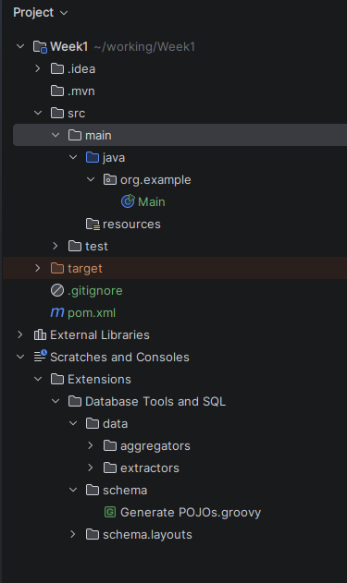
Consoles
The Consoles are saved interactive console sessions
There are three types used in this course
  Database consoles
    An .sql file that IntelliJ saves so queries are not lost when the IDE is closed
  HTTP client consoles
    Unsaved .http request files land here before they are explicitly saved to the project
  Language consoles
    When a Groovy or other REPL-style console is opened, the session is stored here

Slide 10
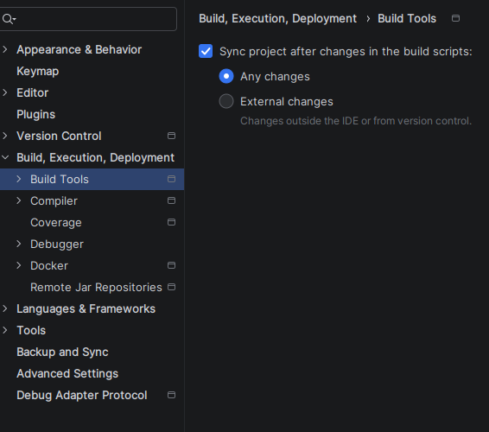
Auto-Import
Maven auto-import
  IntelliJ can watch the pom.xm file
    Can automatically synchronize its internal project model whenever a dependency is modified
    Without this, manually triggering Reload Project every the pom.xml is edited
  This has to be turned on in the settings as shown here
  Triggered every time a Spring Boot starter, a dependency added, or change is made to a a plugin version
  Without auto-import phantom compilation errors can occur that are simply stale classpath entries

Slide 11
File Encoding
File encoding
  On Windows development machines, the default system encoding is often Windows-1252 or CP-1252
  Java expects UTF-8 for source files, resource files, and configuration
  Mismatched encoding causes silent data corruption in string literals
    Particularly visible in JSON payloads, SQL statements with special characters, and internationalized error messages
    Best case: compile error
    Worst case: causes source files to be misread as garbled tokens

Slide 12
File Encoding
How corruption typically happens
  Created or edited on Windows in Notepad
    This app historically defaulted to UTF-16
  Copied from a Windows SharePoint or Teams file share onto a Linux build server
  Generated by a tool (Word, Excel export) that produces UTF-16 by default
  Edited by a developer whose IDE was misconfigured

Slide 13
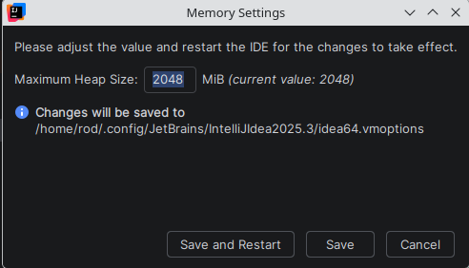
IDE Memory
IDE memory settings
  Found under the Help menu
  Spring Boot projects with multiple modules, Kafka, Oracle drivers, and test containers can require substantial heap
  IntelliJ ships with conservative defaults (512MB–1GB) that cause noticeable slowdown on large projects
    Refers to the memory used by the IDE, not the JVM used by the application
  Increasing the heap eliminates the most common source of IDE lag on Spring builds
  Set minimum to 2048 MB for any project with multiple Spring Boot modules
    4096 MB is reasonable on a 16GB+ machine

Slide 14
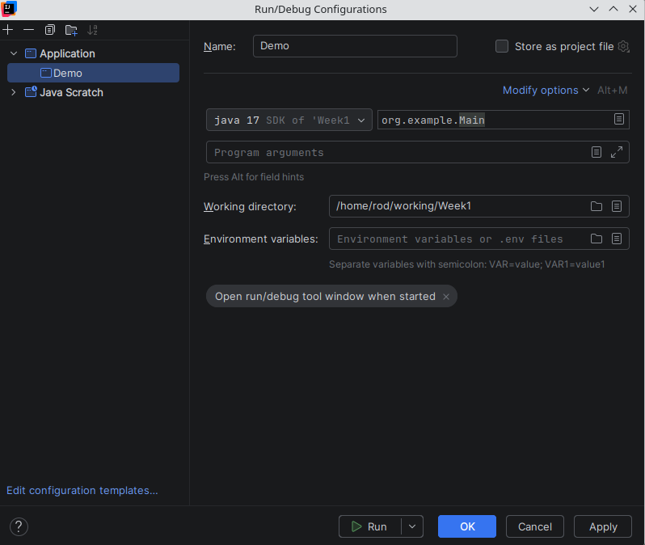
Run Configurations
A saved, named set of instructions that tells IntelliJ how to launch something
  Can be a Java application, a test class, a Maven goal, a Docker container, a remote debugger connection or a Spring Boot applications.
  Determines exactly what happens when the run button is pressed
  The first time the the green play button is selected a temporary Run Configuration is created but not saved

Slide 15
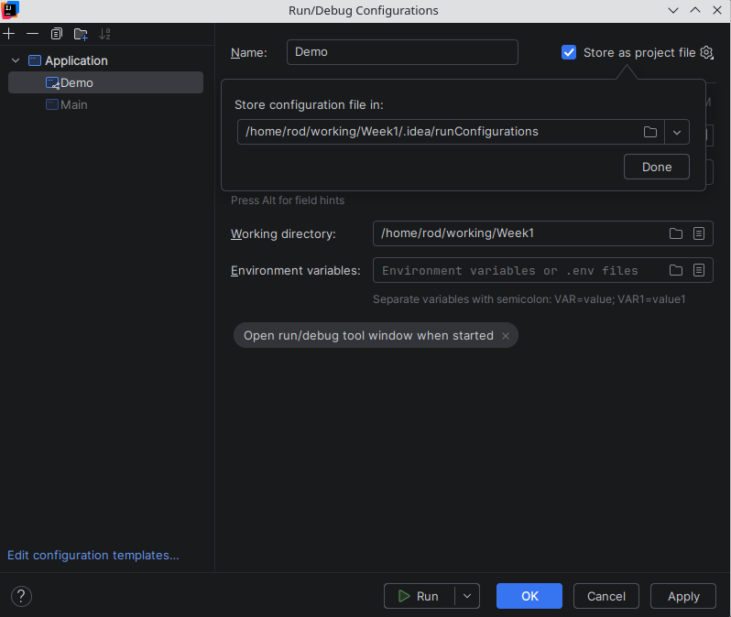
Run Configurations
Three states for a Run Configuration
  Temporary
    Created automatically when you click Run next to a main() method.
    IntelliJ keeps only the last few and then deletes old ones
  Permanent
    Saved locally in your IDE
    Survives IDE restarts
    Created by saving a temporary configuration or by creating one manually
  Shared
    Stored .idea/runConfigurations/ as an XML file and committed to Git
    Every developer who clones the repo gets the same Run Configurations automatically

Slide 16
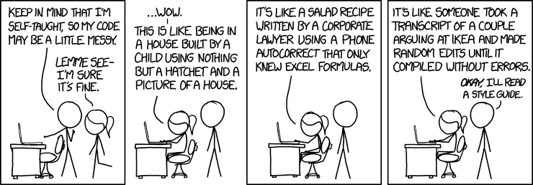
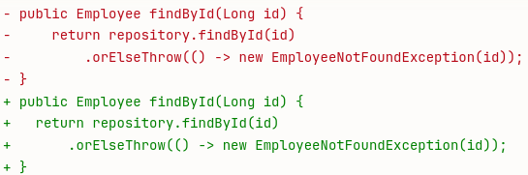
Code Style and Editor Config
The merge conflict problem
  Two developers working on the same file
  One is configured to use 4-space indents
  The other is configured to use tabs
  Neither changes the code logic
  IntelliJ auto-formats on save so that every single line in the file appears as a change in Git
    Git sees this as every line being deleted and rewritten
  The goal of code style enforcement is to make every line in every diff meaningful
Image Credit: https://xkcd.com/1513

Slide 17
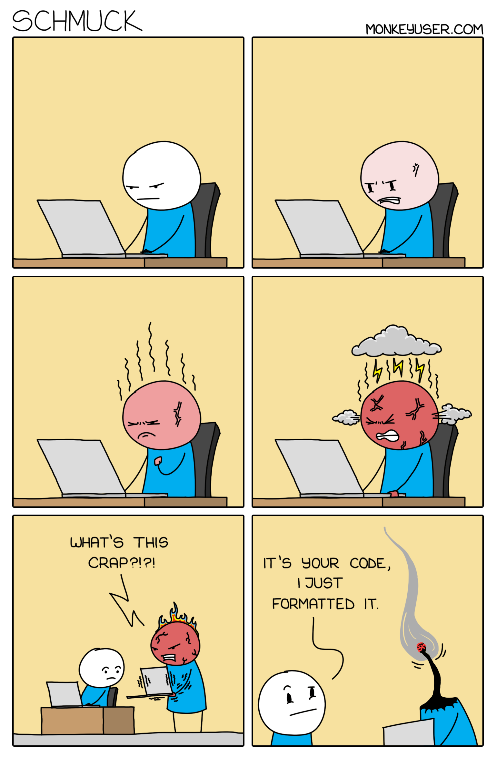
Code Style and Editor Config
Code style covers two distinct categories of rules
Formatting rules
  Purely cosmetic and do not affect compilation or runtime behaviour
  They only affect how the source text looks on screen and on disk
    Indentation (tabs vs spaces, how many spaces)
    Line endings (LF vs CRLF)
    Where braces go (same line or next line)
    Maximum line length
  Controlled by .editorconfig and IntelliJ's code style settings
Image Credit: https://github.com/ichimax/Java-Style-Guide

Slide 18
Code Style and Editor Config
Code quality rules
  These affect the structure and correctness of the code itself
    Naming conventions (camelCase for methods, PascalCase for classes)
    Whether to use `var` or explicit types
    Whether fields should be `final`
    Import organization (no wildcards, grouped by package)
    Complexity limits like max method length
  Controlled by IntelliJ inspections, Checkstyle, or SonarQube
Image Credit: https://github.com/ichimax/Java-Style-Guide

Slide 19
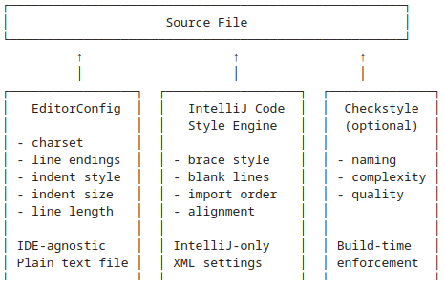
Code Style and Editor Config
Understanding the tool stack
  These affect the structure and correctness of the code itself
    Naming conventions (camelCase for methods, PascalCase for classes)
    Whether to use `var` or explicit types
    Whether fields should be `final`
    Import organization (no wildcards, grouped by package)
    Complexity limits like max method length
  Controlled by IntelliJ inspections, Checkstyle, or SonarQube

Slide 20
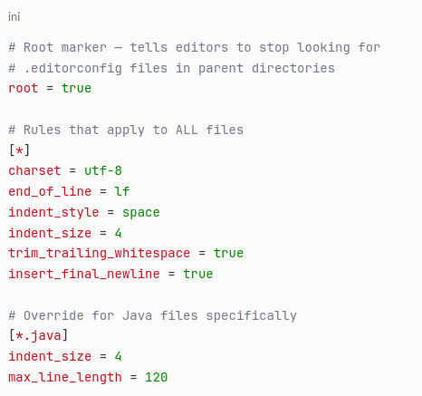
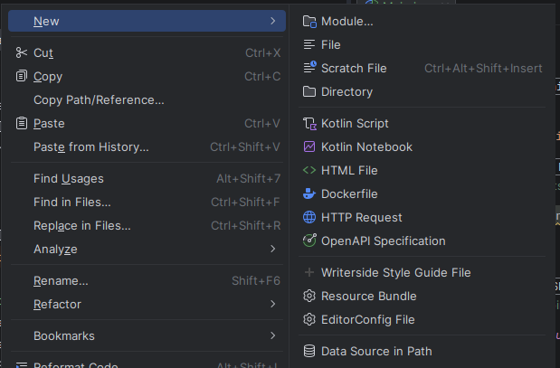
Editor Config
EditorConfig is the baseline
  Plain text file ini format that every modern editor understands
  It enforces the most fundamental formatting rules in a way that works regardless of which IDE each developer uses

Slide 21
EditorConfig
When you open a file, the editor:
  Looks for a .editorconfig file in the same directory as the file
  If not found, walks up the directory tree looking for one
  Stops walking when it finds root = true
  Applies the matching rules to the open file
This hierarchical lookup means
  Use a root .editorconfig for general rules
  Override specific rules in sub-directories

Slide 22
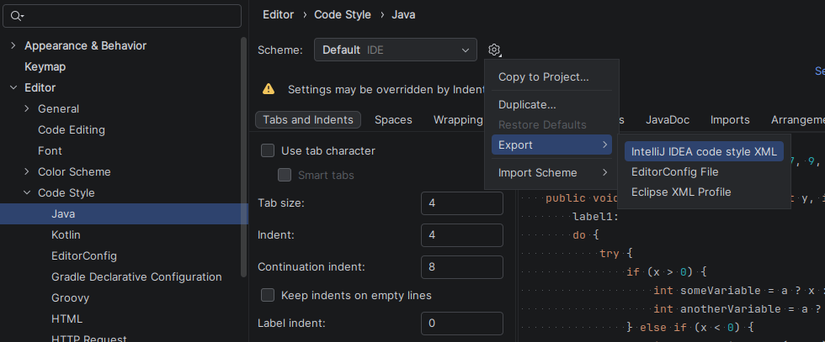
Code Style Engine
Applies IntelliJ-specific settings that EditorConfig cannot express
  Includes format items like
    Brace placement
    Import organization
    Method chaining alignment
Stored in IntelliJ's code style XML
  Can be exported and committed to the repository
  Ensures every team member's IntelliJ uses identical settings

Slide 23
Code Style Engine
Relationship between the two tools
EditorConfig
  Baseline rules for ALL editors
    VS Code, Vim, Emacs, IntelliJ
IntelliJ Code Style
  Richer rules for IntelliJ specifically
  Respects EditorConfig as the foundation
  Adds Language-specific formatting on top
  When both can apply and and a rule exists in both EditorConfig takes precedence for the properties it covers

Slide 24

Checkstyle
Checkstyle is a static analysis tool
  Automatically checks Java source code against a defined set of coding rules
  Reads a .java source files as text and AST (Abstract Syntax Tree) and verifies that they conform to a defined ruleset
  It does not compile the code, does not run it, and does not analyze runtime behavior
  It purely analyses the structure and style of the source text
  Checkstyle is the enforcement layer
    Code does not build until the violation is fixed

Slide 25
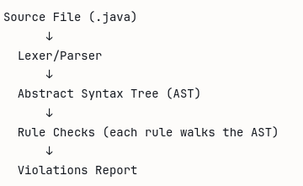
Checkstyle
Ships with standard pre-built configurations
  These are used as a starting point for developing a customized style guide
Google Java style guide
  Used by Google internally and published as an open standard
  Most widely adopted in modern Java teams
Sun coding conventions
  Original Java coding standard from Sun
  Included mainly for backward and historical compatibility

Slide 26
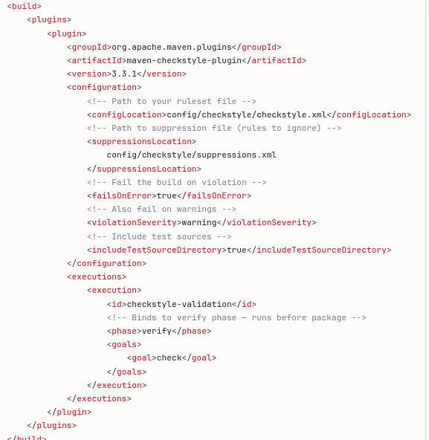
Checkstyle
Integrating Checkstyle into Maven
  Checkstyle is added to the pom file as a plugin as shown
  Can be run automatically as part of the build process
  Or run manually

Slide 27
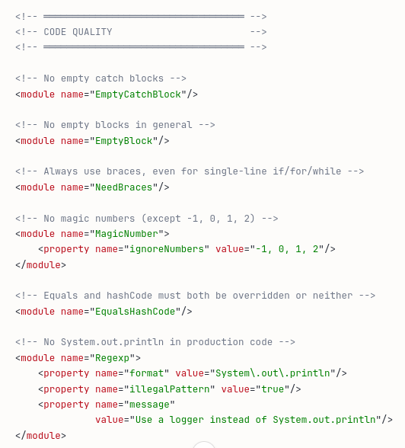
Checkstyle
Checkstyle configuration file
  The configuration file defines exactly which rules are active and how they are configured
  The example of the left is a snippet of part of a Checkstyle configuration file

Slide 28

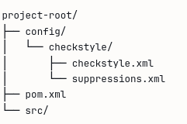
Checkstyle
Checkstyle configuration file
  The location of the file is specified in the pom file as shown
  However, putting it in config/checkstyle/ location is the de facto standard for enterprise Java projects.

Slide 29
Checkstyle
Checkstyle configuration file
  The configuration file defines exactly which rules are active and how they are configured
  The example of the left is a snippet of part of a Checkstyle configuration file

Slide 30
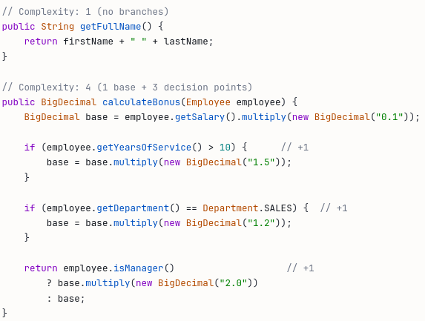
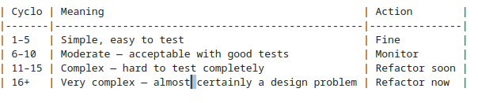
Checkstyle
Cyclomatic complexity
  One of the most useful rules
  Directly correlates with code quality, testability, and maintainability
  Counts the number of independent paths through a method
    Every decision point adds 1 to the complexity
  A method with complexity 15 requires at minimum 15 test cases to achieve full branch coverage
    In practice it rarely gets fully tested, which means it harbours untested paths that become production bugs
  Using `max=10` on forces developers to decompose complex methods into smaller, single-responsibility methods

Slide 31
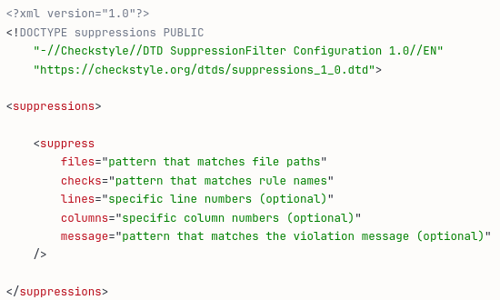
Checkstyle
The suppressions file tells Checkstyle to ignore specific rule violations in specific places
  Prevents the ruleset from becoming so rigid that it blocks legitimate work
  Without a suppressions file, every rule in your checkstyle.xml applies to every Java file in your project with no exceptions
  There exists situations where a rule violation is either unavoidable, irrelevant, or would require more harm than good to fix

Slide 32
Checkstyle
Where Checkstyle should not apply
  Generated code
    JPA metamodel classes, Protocol Buffer generated classes, JOOQ database classes, and similar auto-generated sources
    Ffrequently violate naming conventions, line length limits, and complexity rules.
    Not written by developers and should not be reviewed as if they were.
  Legacy code being migrated
    Applying to an existing codebase, would produce thousands of violations that have nothing to do with the work in progress
    A pragmatic migration strategy suppresses violations on legacy files while enforcing rules strictly on new code.

Slide 33
Checkstyle
Where Checkstyle should not apply
  Test code
    Legitimately use magic numbers as test data
    Have long method bodies that set up complex scenarios
    Use naming conventions that violate production naming rules.
  Framework constraints
    Some frameworks require specific patterns that violate style rules
    For example, Spring's @Configuration classes sometimes have long methods
    JPA entities sometimes require default constructors that Checkstyle's design rules would flags

Slide 34
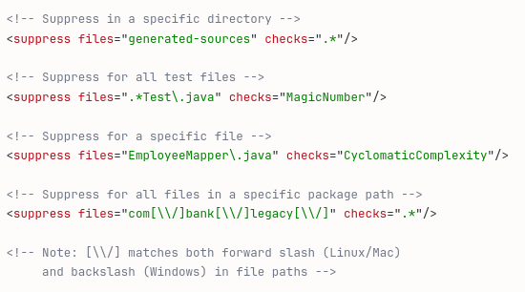
Checkstyle
Applying suppression rules
  Can specify which files, directories and rules should be suppressed
  Regex can be used for both arguments

Slide 35
Checkstyle
Applying suppression rules
  Can specify which files, directories and rules should be suppressed
  Regex can be used for both arguments

Slide 36
Questions?

